Slide 1

From waste to walls. Intentional surfaces

Slide 2

ALTARIZE
Your kitchen
already works
in circles.
Scraps become stock. Waste becomes compost. Nothing is thrown away without purpose.
Bali Restaurant Association · 2025

Slide 3
ALTARIZE
The building that
holds your restaurant
doesn't.
8%
35 mm
3–5 month
of all global CO₂
comes from cement alone
of traditional terrazzo
needs to be laid each time
before most surfaces
crack, mould, or need replacing

Slide 4
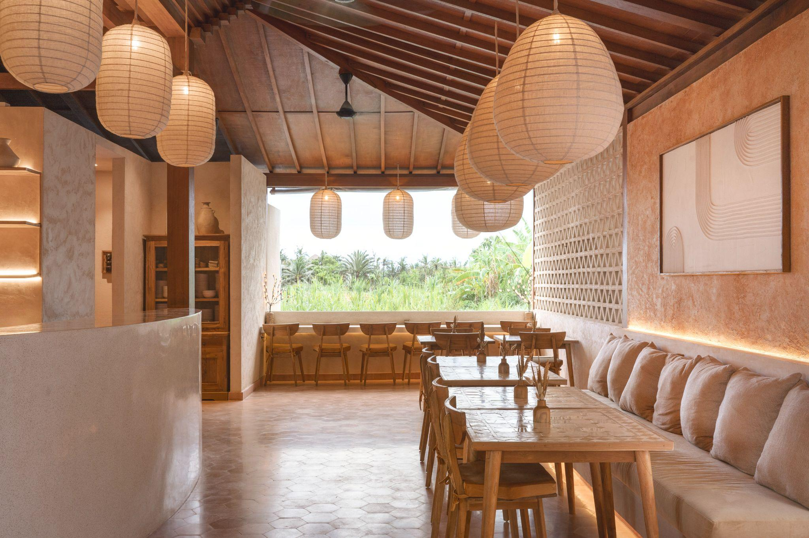
ALTARIZE
Nature has always
built this way.
Shells become limestone.
Leaves become soil.
Dead matter becomes the foundation of new life.
The circular loop in construction is not an innovation. It's a return.

Slide 5
ALTARIZE
Bali already has
everything it needs.
The waste streams sitting in your kitchen right now:
Glass bottles
Oyster & mussel shells
Egg shells
↓ replaces mined sand
↓ aggregate for
natural renders
↓ calcium carbonate
Sawdust & rice husk
Ceramic waste
Cork & fabrics
↓ plant fibre in
insulating base coats
↓ mineral filler in
microcement systems
↓ acoustic & thermal
insulation boards

Slide 6
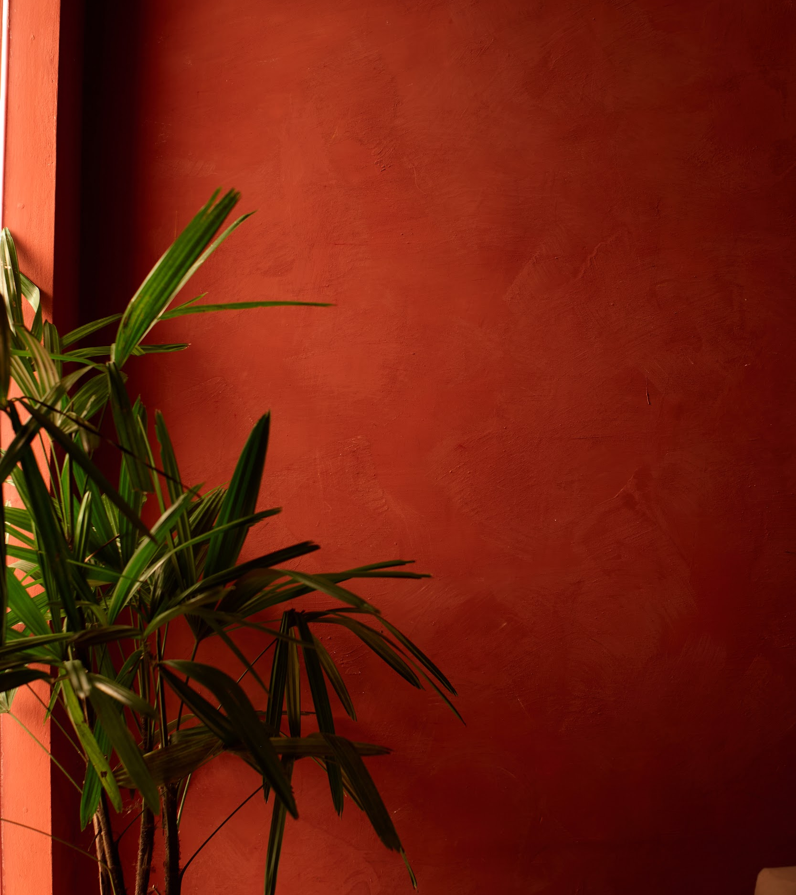
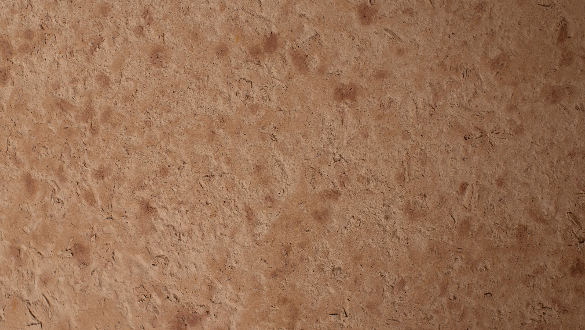
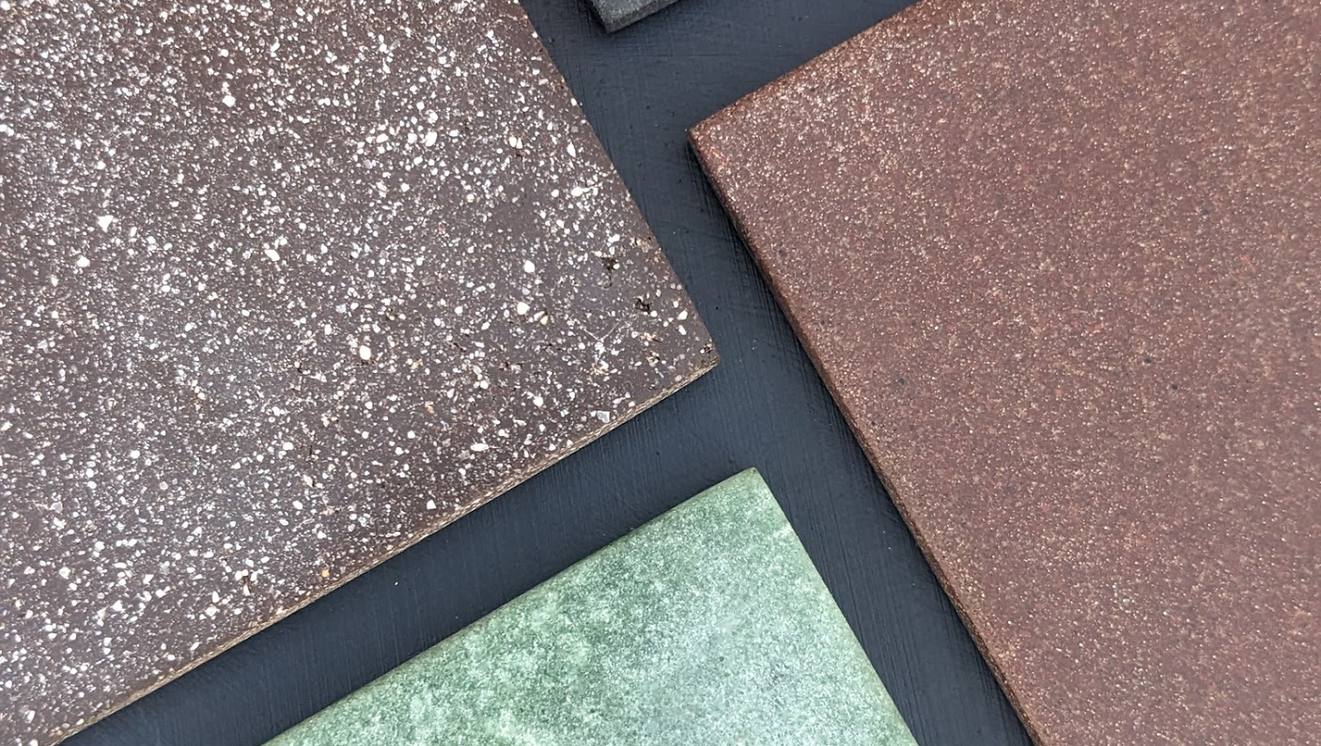
ALTARIZE
Surfaces made from
what was thrown away.

Slide 7
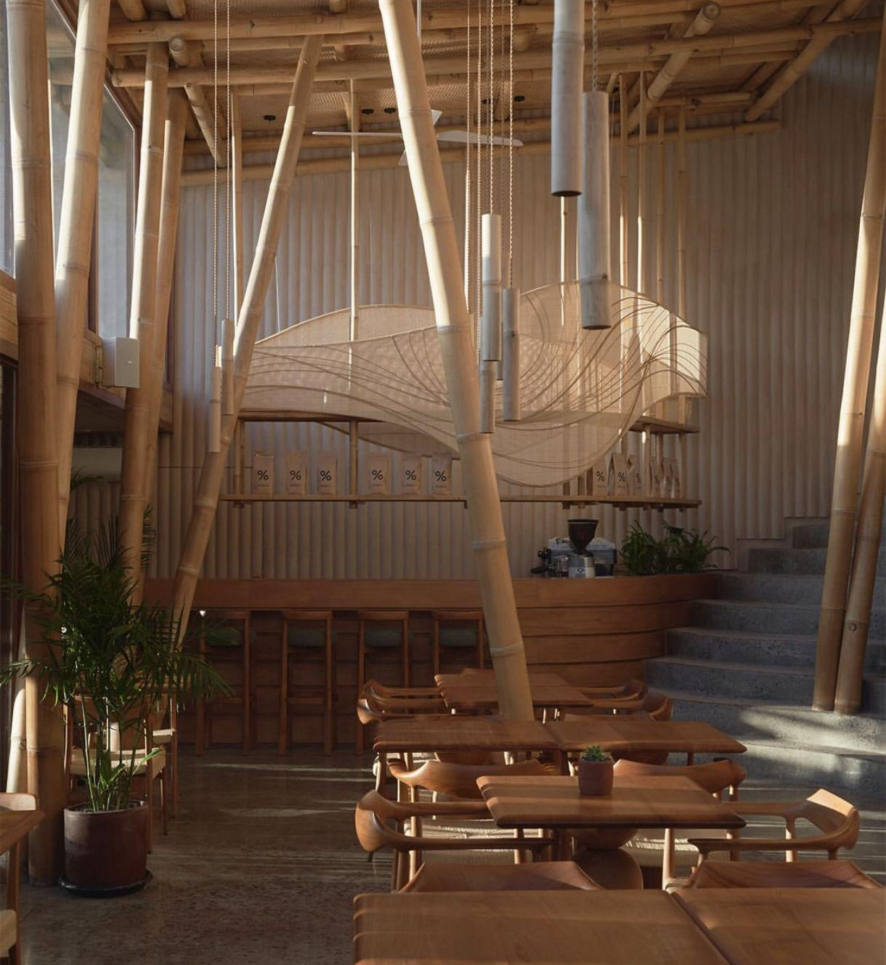
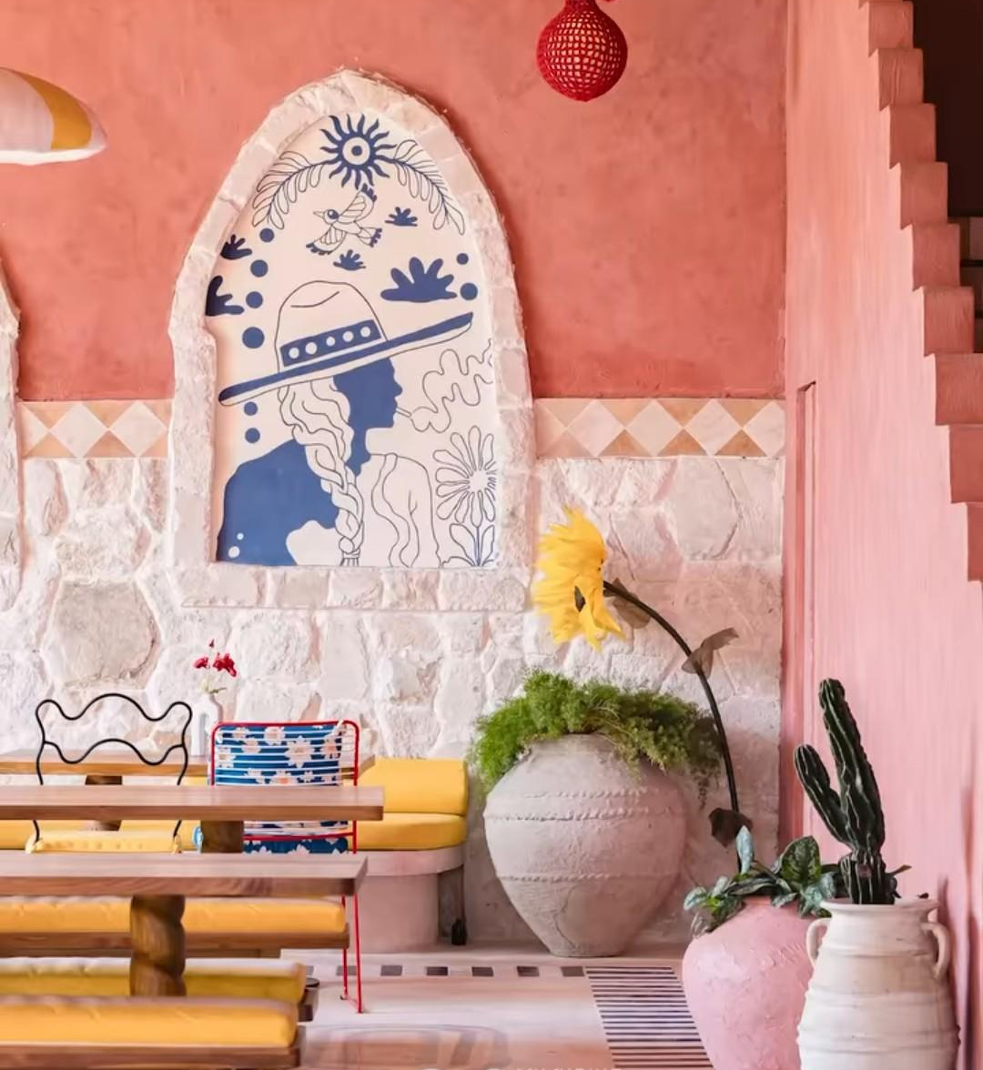
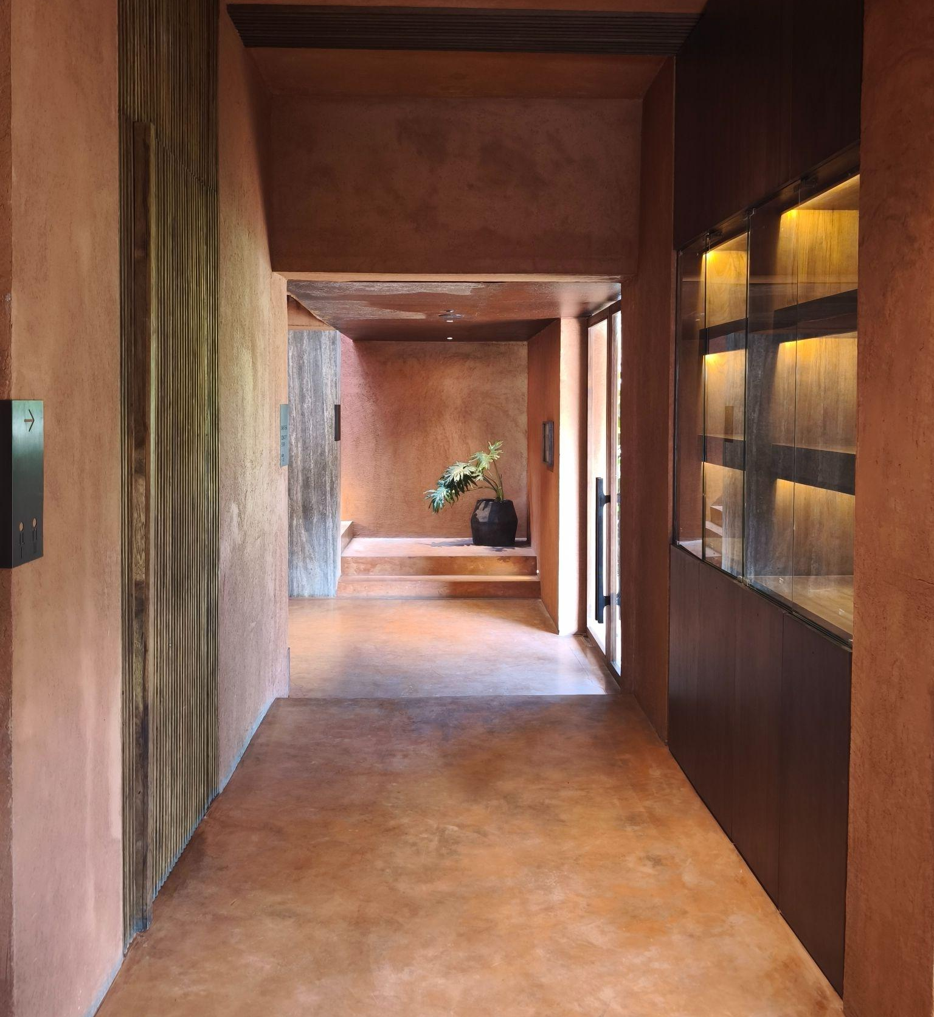
ALTARIZE
Already part of Bali and beyond.
Alchemy Canggu
Tacos Aqui
Further Hotel
lime plaster throughout
limewash exterior & interior
microcement & natural paint
300+ projects · Bali, Lombok & beyond

Slide 8
ALTARIZE
What one small company
did in one year.
1200 t
46 t
180000
of CO₂ avoided —
equivalent to 300 cars off the road
of waste diverted from
burning and landfill
m2 covered
100% cement-free interior systems
Now imagine this at the scale of an industry.

Slide 9
ALTARIZE
Construction is one of
the most polluting industries
on earth.
It doesn't have to stay that way.
Waste streams from hospitality become the raw material of construction
Buildings sequester carbon rather than emit it
Local ecosystems are preserved because we stop mining sand and extracting virgin materials
The built environment becomes part of the regenerative cycle — not outside it

Slide 10
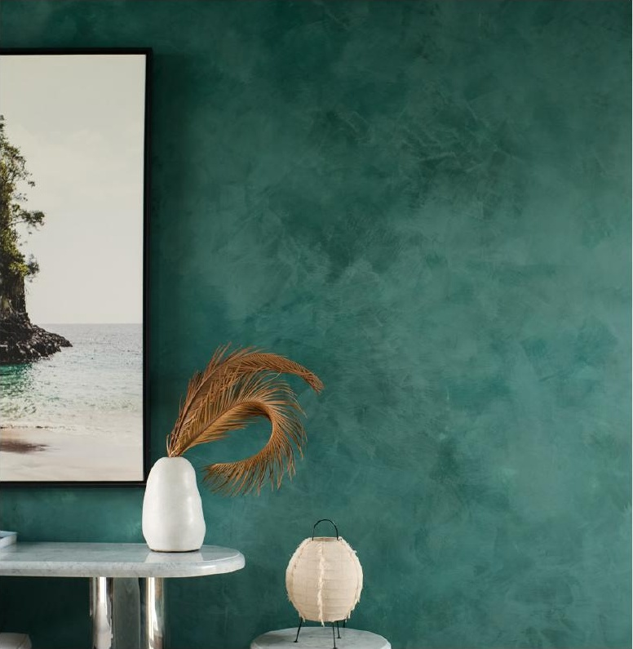
ALTARIZE
Your kitchen
is already part
of this.
The shells from your seafood. The bottles from your bar. The ceramic off-cuts from your renovation.
We collect them.
We turn them into the walls
of Bali's next spaces.

Slide 11
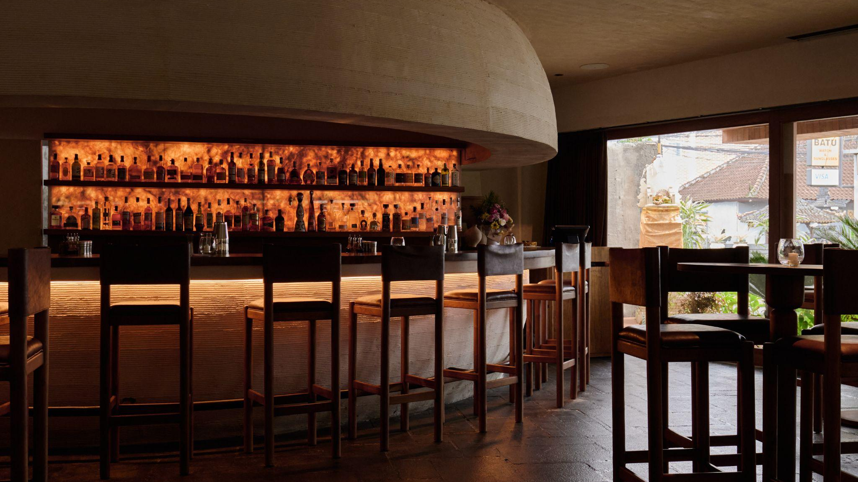
If your kitchen
can work in circles,
so can your walls.
hello@altarize.com · @altarize.materials · altarize.com
WA: 0819-4335-1413 · Bali, Indonesia
MATERIALS THAT MATTER

